Slide 1
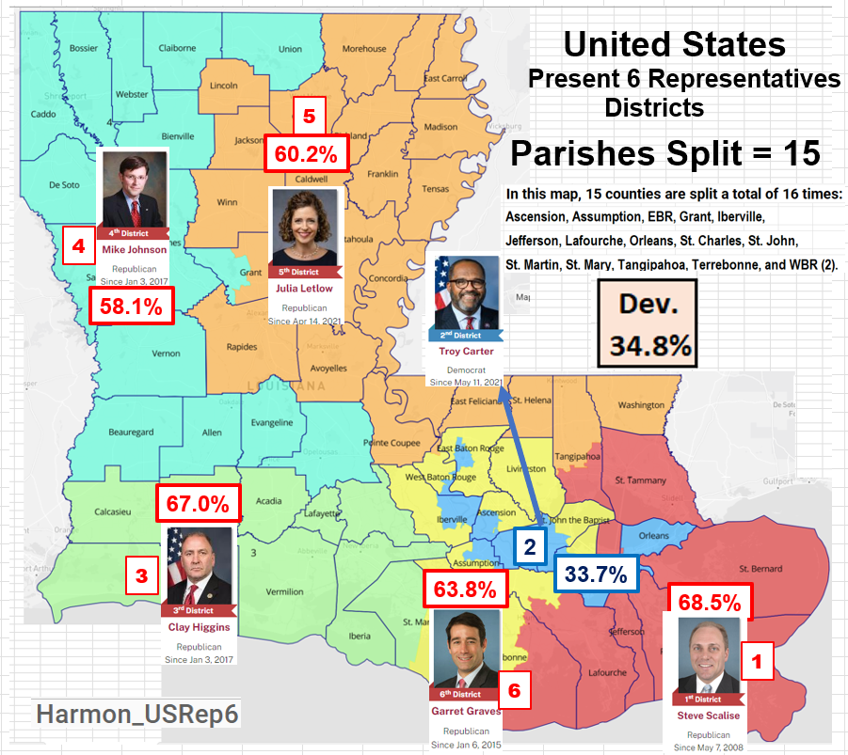
This is our present US House of Representative six Districts. These districts were redrawn last year ( as required) per the 2020 census.
Note: While our ex-Governor did not approve of these districts, ( he demanded the State Legislators resubmit a map with 2 minority districts). Thus, returning the task back to the State Legislators in 2022.
The Legislator, upon reconsideration, 2/3
of the member of both Houses re-approved these districts, thus overriding his veto.
Now the courts are requiring the State Legislators to redraw this map to include two minority districts.

Slide 2
Now the courts have questioned the fairness of our US six House District as drawn by our State’s Legislative bodies with a mandate not only does the map need to be redrawn, but it is required to contain two minority districts.
The court appears to agree with our ex-Governor. The State being 57% white, two minority districts must be the results of the new re-districting map for our Louisiana US House of Representative Districts.
A closer look at the layout of our state will show why the demand for a second minority district is faulty reasoning and lacks merit.
We’ll begin with an overview of the State based on the present State Senatorial districts.

Slide 3
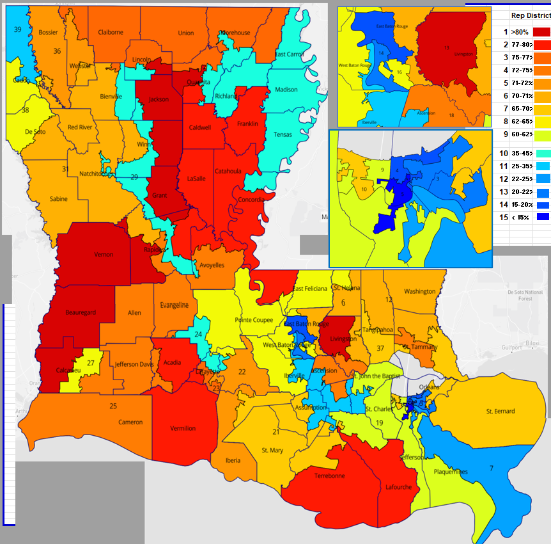
This map shows our present 39 Senatorial Districts. Deeper red more Republican, deeper Blue more Democrats, yellow/green more evenly split. (Legend included).
With the requirement Louisiana is allocated six US Reps., simple math means one US House District would require 6.5 Senatorial Districts. (39/6 = 6.5).
Looking at the northern part of the State, we clearly have only 3 blue districts and none of them dark blue. This easily removes the northern part of the state as a candidate for a minority district. (without serious gerrymandering to achieve that goal.)
An objective look at the remainer of the state shows one area (Greater New Orleans) dictates a minority district with its deep blues and NO red areas and a possible second two minority district in the Baton Rouge area.
With the understanding one minority district should be drawn in the NO area, now let’s focus on the Baton Rouge Area.

Slide 4
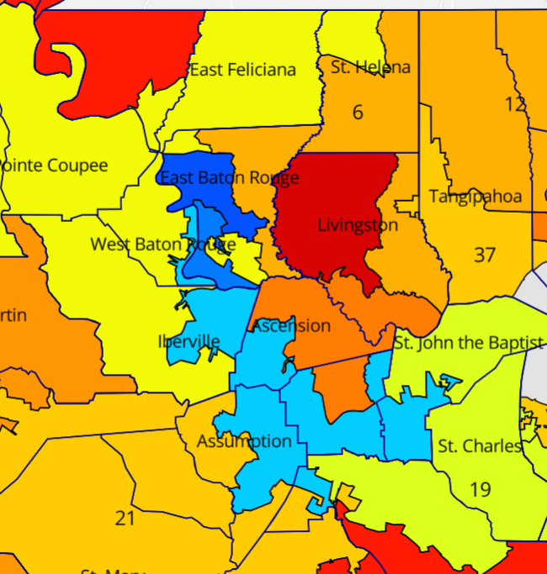
This map of the Baton Rouge Area clearly shows the issue with drawing a second possible minority district. Let’s explain further…
The requirement 6.5 Louisiana Senate Districts to makeup one US House District. The second possible minority district has only three districts with only one of those being dark blue as a starting point, and it is block to the east by one of the reddest parishes in the State.
As this map clearly shows a second minority district is not easily drawn. It WILL require Gerrymandering to obtain that goal.
Hopefully, this puts the misconception of a second minority district off the table, lets look at another approach. One closely tied to Election Integrity.

Slide 5
Again the goal, to increase Election Integrity by minimizing division of our State Parishes.
We have 64 parishes in the great state of Louisiana.
Let’s approach the redrawing of the State’s US House Representative districts using parishes as our criteria.
Per the 2020 Census each US House District requires a contiguous make up with a population target of 776,293. (+/- .075%).
Working through multi variations, a clean solution with only ONE parish being split was achieved .
With my engineering background, this task started as most of my tasks with a basic block diagram.

Slide 6
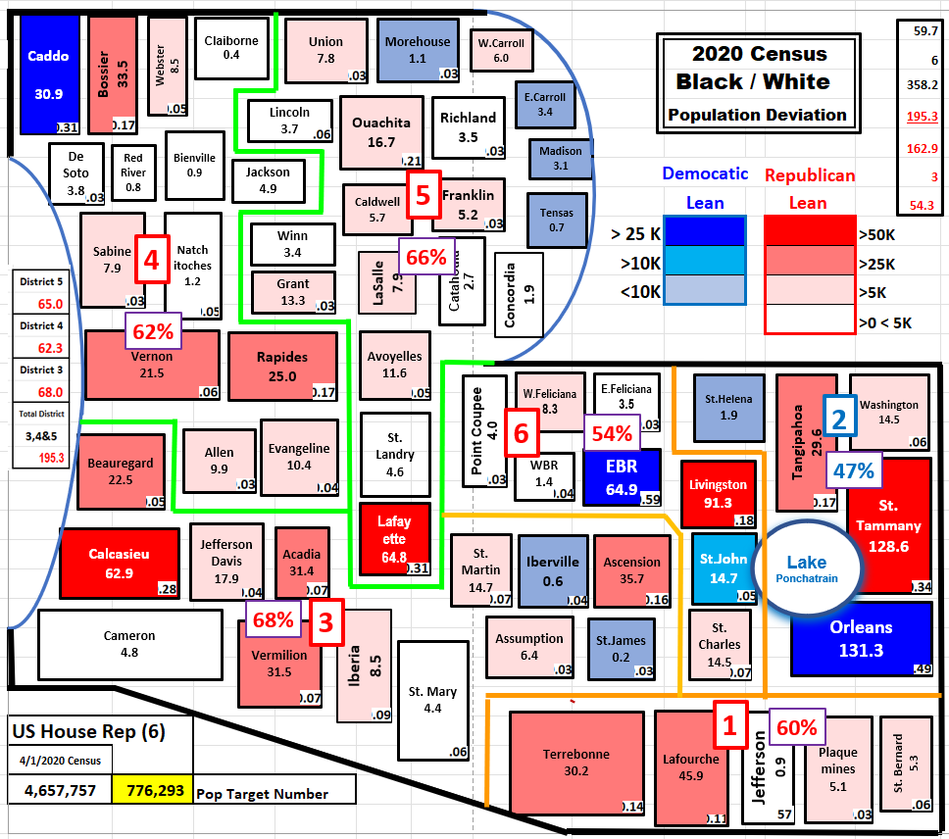
La. Parishes Block Diagram
This is my block diagram.
The number below the parish name is the deviation number is thousands (k units ; Reds: +Republican, Blues: +Democrats). The number in the lower right-hand corner is the percent that parish contributes to a US House district.
The green dividing lines depict the three districts on the west side of the State (districts 3,4 & 5) and the blue dividing lines depicts the three districts on the east side of the State (1,2 & 6).
A copy of the follow up detail worksheet is on the next panel.

Slide 7
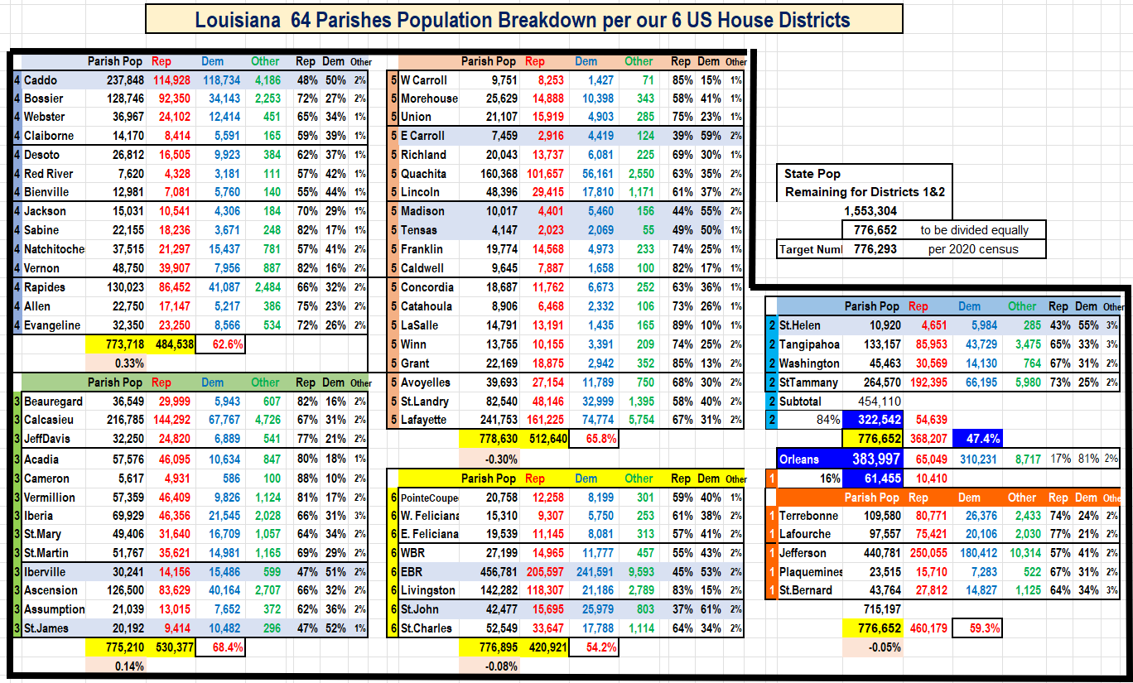

Slide 8
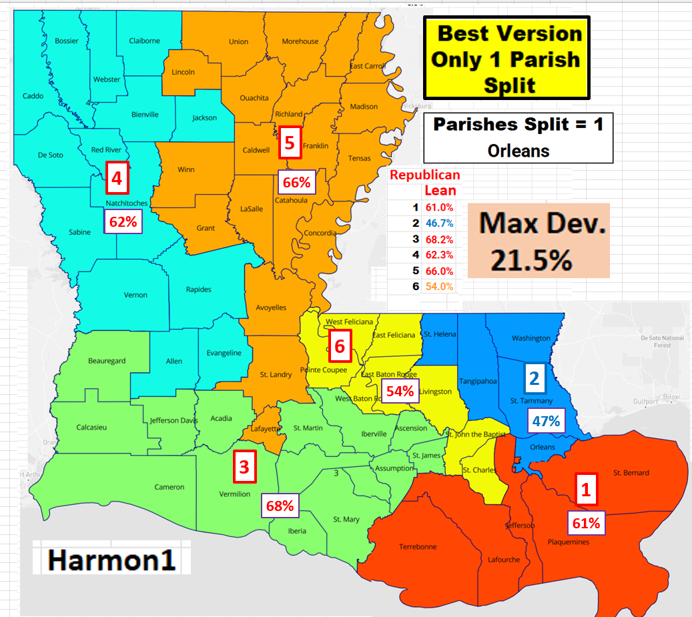
This is the final map based on the parishes. Now the information was inputted on the wonderful website DRA2020, titled Harmon1.
This US House of Representatives map which contains NO gerrymandering, maintains our one minority district but most importantly, it maintains the integrity of 63 of our 64 parishes, a key factor in helping with election integrity moving forward.
Sidenote: The one parish split – Orleans.
This was required for the map to be complaint. The area of Orleans required to be allocated to District 1 from District 2 is basically the area of Orleans parish my Senator and our newly elected Senate President Cameron Henry has of Orleans parish in his present State Senate district.

